Slide 1
A NYQUIST BASED UNIFIED ANALYSIS METHOD ON SPONTANEOUS OSCILLATION CONDITION FOR THERMOACOUSTIC SYSTEMS WITH APPLICATION TO STANDING- AND TRAVELING-WAVE ENGINES
Kobayashi Yasuhide, Nakata Takumi, Yamada Noboru
Nagaoka University of Technology, JAPAN

Slide 2
Introduction
Attenuation of spontaneous oscillation
to prevent mechanical damage
active noise control[Delgado et al.2003]
Utilization of oscillation
less application of control eng.
not admitted electrical power input
Aim: application of control eng.
standing-wave attenuation
stability analysis … present study
system design
sound wave
cold
output
heat
source
thermoacoustic refrigerator

Slide 3
Introduction (cont.)
Estimation of onset condition CTR etc.
complex structured stack and heat exchangers
⇒ experimental-based
frequency response measurement of subsystems [Hatori et al.2012] [Guedra et al.2011]
equality conditions of onset
not easy to estimate of oscillation
with stability/instability margin
cf. Nyquist stability criterion in control eng.

Slide 4
Introduction (cont.)
Nyquist stability criterion for SISO system
combustion instability analysis [Kopitz and Polifke 2008]
unified procedure for standing- and traveling-wave systems has not been discussed
【GOAL】 unified procedure
system representation on traveling-wave pressure components
Nyquist stability criterion for MIMO systems
good agreement between experiment and analysis

Slide 5
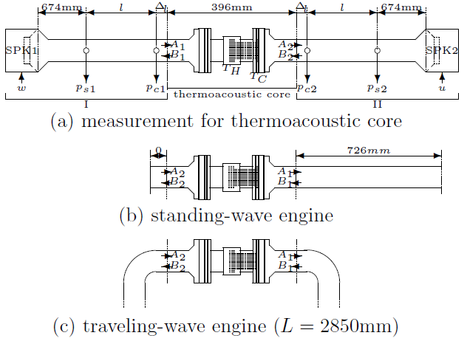
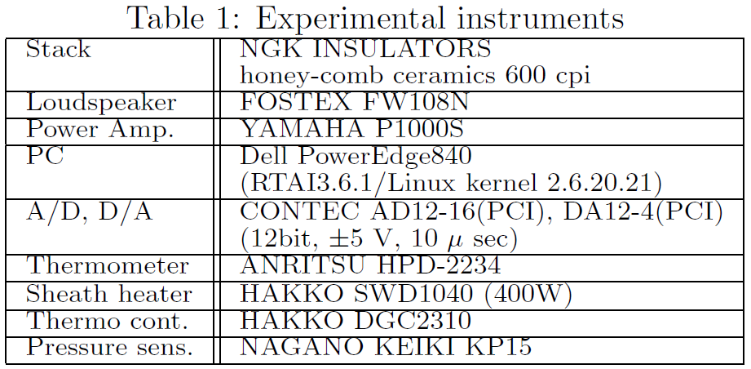
Experimental apparatus
768mm
768mm
34mm
34mm
φ47mm
55mm in length
1mm ×1mm
T_{H} > 150℃
⇒ osc.@70Hz
T_{H}℃ | T_{C}℃
21 | 21
100 | 23
200 | 26
300 | 29
400 | 33
no oscillation

Slide 6
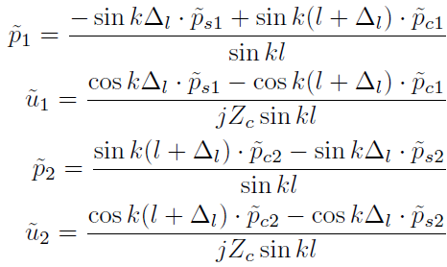
Transfer-matrix-based analysis

Slide 7
Transfer-matrix-based analysis (cont.)
with equality conditions [Guedra et al. 2011]
traveling wave:
standing wave:
input-output relation is not causal
unified procedure is not possible

Slide 8
Conversion to causal system representation
Ex： T_{tube}
A₁
A₂
B₁
B₂
x
0
l
A₂
A₁
B₂
B₁

Slide 9
Proposed method
freq. resp. measurement for causal sys. representation
G_{core}
G_{tube}
G_{core}

Slide 10
Proposed method (cont.)
Nyquist stability criterion
Closed-loop system is stable
⇔ locus of does not encircle the origin
G_{core}
G_{tube}

Slide 11
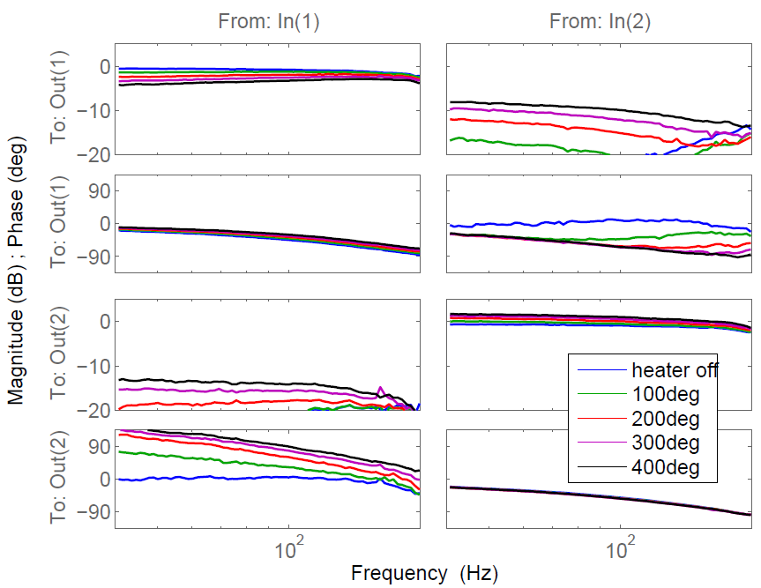
Result: frequency response of G_{core}
G_{core}
From: A₁
From: B₂
T_{H}:larger
To: A₂
T_{H}:larger
To: B₁
40
100
200
40
100
200

Slide 12
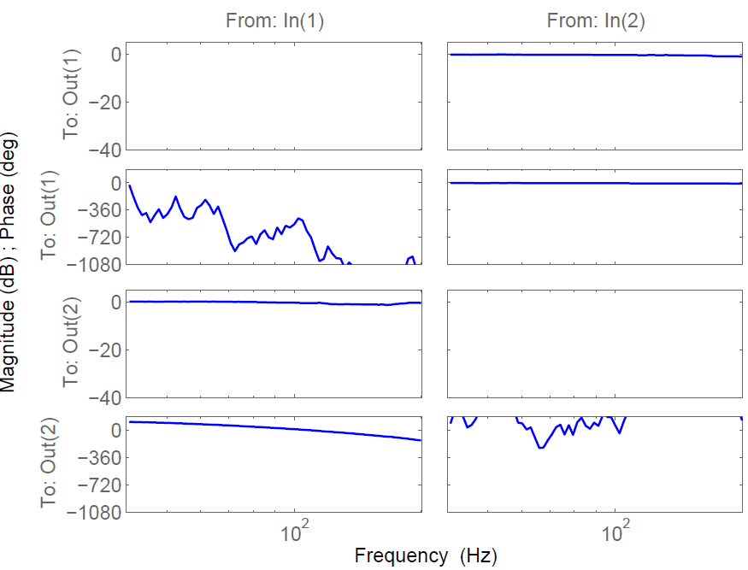
Result: frequency response of G_{tube}
Standing-wave engine
From: A₁
From: B₂
To: A₂
To: B₁

Slide 13
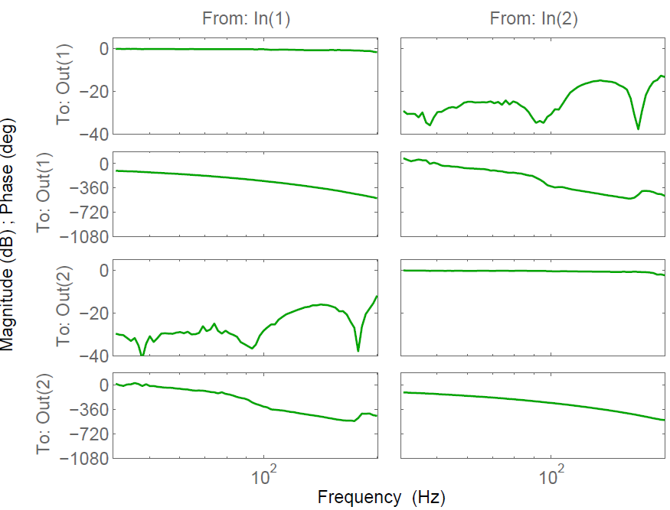
Result: frequency response of G_{tube} (cont.)
Traveling-wave engine
From: A₁
From: B₂
To: A₂
To: B₁

Slide 14
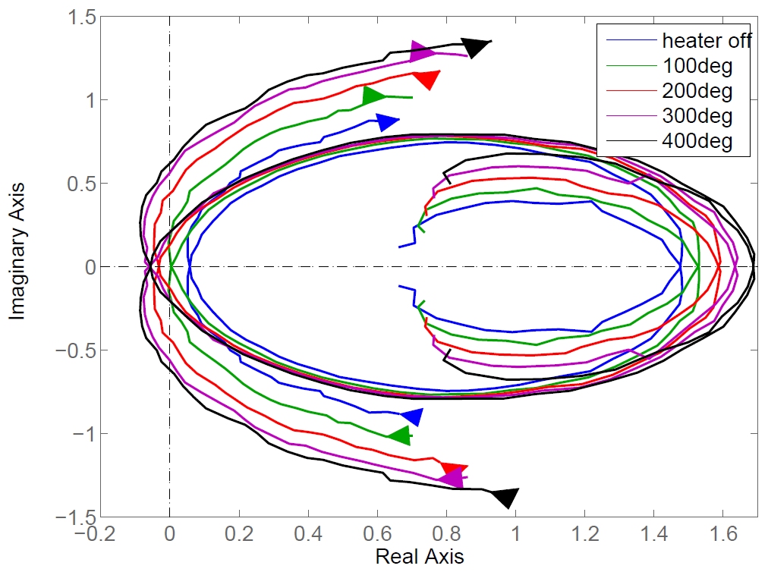
Analysis result: standing-wave engine
70Hz
200Hz
40Hz
Ｔ_{Ｈ}：higher ⇒ larger instability margin

Slide 15
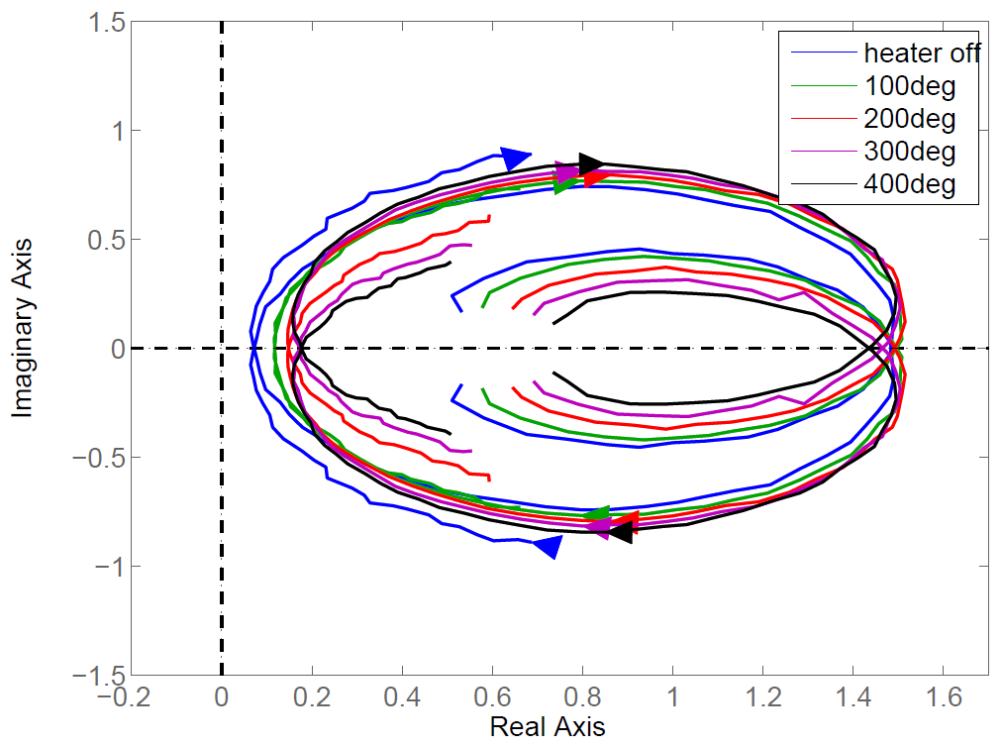
Analysis result: standing-wave engine(cont.)
with inverted core
Ｔ_{Ｈ}：higher ⇒ larger stability margin

Slide 16
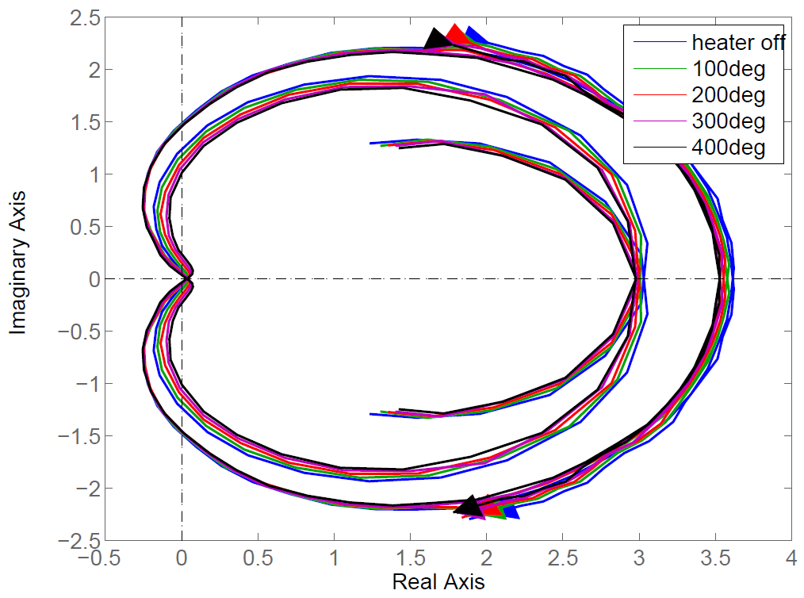
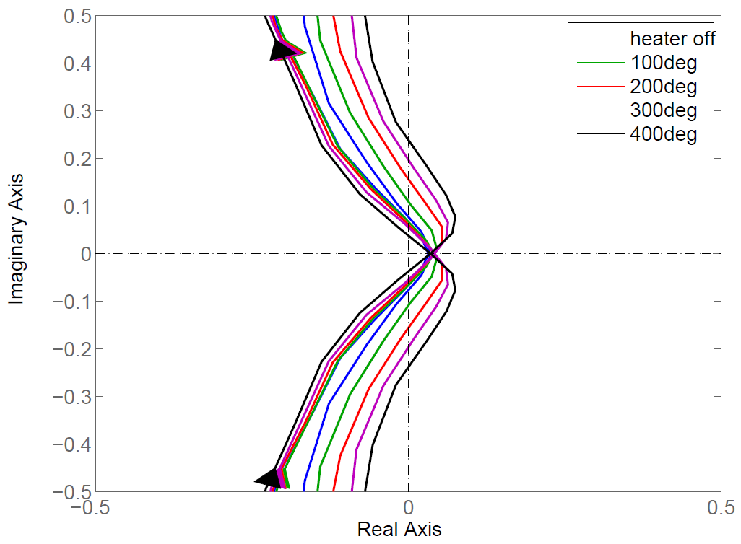
Analysis result: traveling-wave engine
T_{H}：higher ⇒ less stability margin

Slide 17
Conclusions
A unified stability analysis method for standing/traveling-wave systems based on the Nyquist stability criterion for MIMO systems
(measured) frequency response of subsystems
causal MIMO system representation on traveling-wave pressure amplitudes
Estimated oscillation conditions are consistent with experimental results
standing- and traveling-wave engines
reasonable stability and/or instability margins

Slide 18
Calibration of frequency response
measurement of a short tube δ in length
measurement of short tubes with closed end
calibration

