Slide 1
The effect of open and short circuit of piezoelectric element towards the resonance frequency of cantilever beam bonded with piezoelectric element
NUR AFIFAH NABILA BINTI AZHAR
18306091
Academic Advisor
Associate Prof. Kobayashi Yasuhide
25th Feb 2020

Slide 2
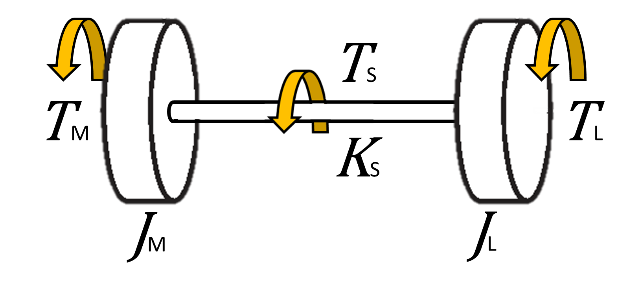
INTRODUCTION
Excitation of the resonant frequency will degrade system performance in both short term accuracy and long term maintenance issues.
Figure 1 : 2-Inertia torsional vibrating system
IN 2-INERTIA TORSIONAL VIBRATION
motor is used in the drive unit of a lightweight and high-speed industrial machine, there is problem of low rigidity and high moment of inertia ratio.
Due to disturbance, undesirable mechanical resonance is generated
Method of disturbance suppression is important
Does not require energy from outside and can vary mechanical characteristics
SEMI-ACTIVE DAMPER COUPLING (SADC) [1]
as a method of disturbance suppression
[1] R. Kobayashi, "Development of a semi-active-damper coupling for variable damping characteristics of two-inertia system," Nagaoka University of Technology, Mechanical Engineering Department Poster Presentation, Nagaoka, Japan, 2018.
Notes:
比強度（密度当たりの強度）鉄とアルミを上回るため、強度を保ったまま、車体を軽くすることができる。
添加合金元素量が少ないために、一般的な商用mっ合金に比べて、強度が劣る。
発火温度はca添加量が増加するにつれて高くなり、溶解・鋳造時の作業性改善や構造部材としての実用化を検討する場合には、少なくとも0.5%以上の添加が必要であると考えられる
al濃度が4.0wt%以上になると腐食速度が急速に低下する。すなわち、al添加量の少ない希薄ｍｇ合金は、耐食性も低いと考えらる
＃＃＃tulis sankou
####tambah graf al

Slide 3
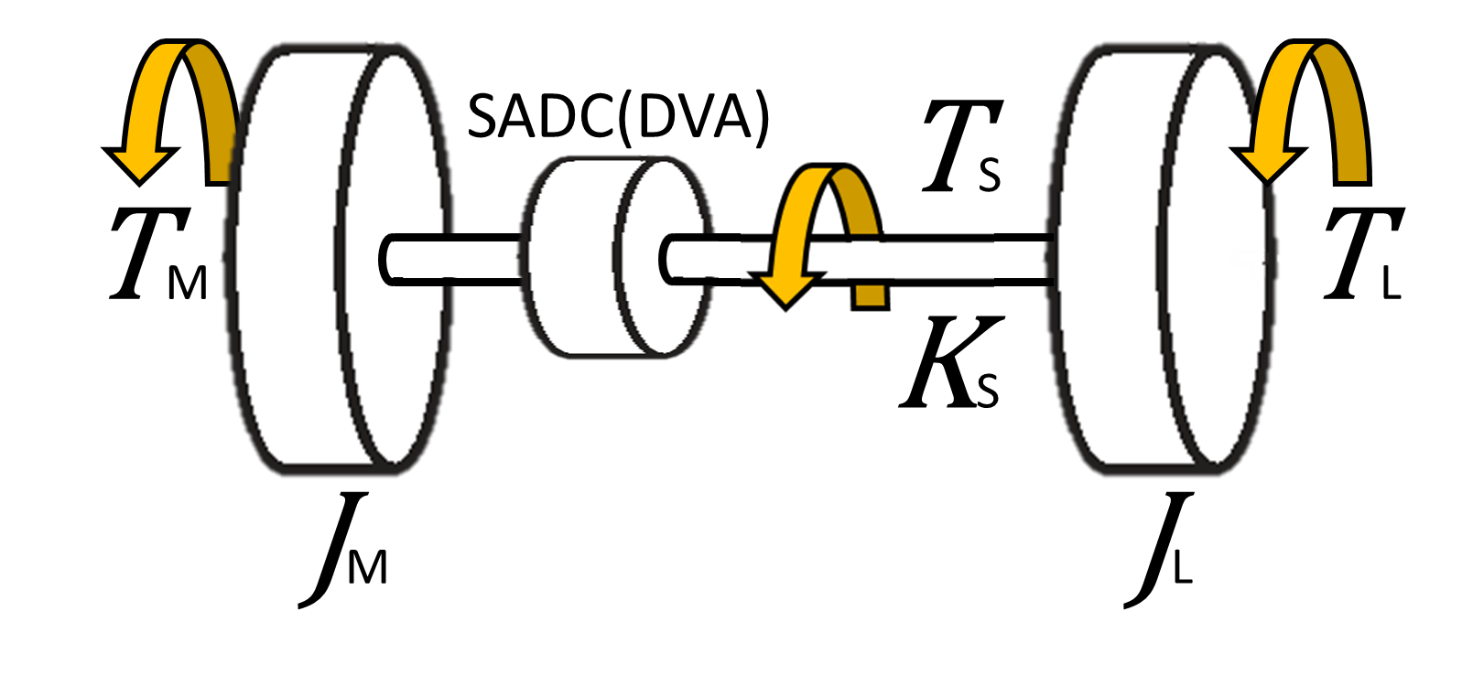
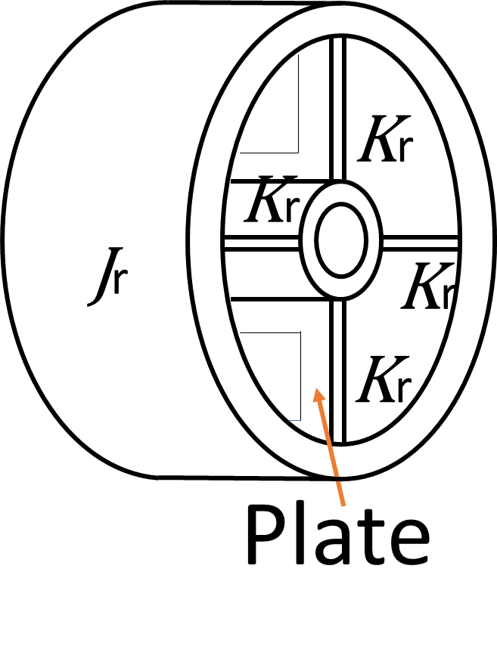
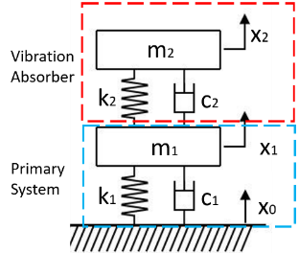
PROPOSED MODEL FOR DISTUBANCE SUPPRESSION
IDEA OF INSTALLATION OF SADC
SADC(DVA)
$$T_{M}=Motor Torque$$
$$J_{M}=Motor’s inertia$$
$$T_{L}=Load Torque$$
$$J_{M}=Load′s inertia$$
$$T_{S}=Shaft Torque$$
$$J_{r}=SADC’s inertia$$
$$K_{S}=Spring constant of shaft$$
$$K_{r}=Spring constant of spring$$
$$plate and piezoelectric actuator$$
Figure 2 : (Left) 2-inertia torsional vibration system with installed SADC, (Right) The Close-up look for idea of SADC model
DYNAMIC VIBRATION ABSORVER (DVA)
DVA is an additional system that is tuned to counteracts the force from the vibration imbalance
Figure 3 : Schematic Diagram for DVA [2]
[2]I. Chikashi, "Control of vibration amplitude by generation and regeneration," Bachelor of Master Degree Thesis , Mechanical Engineering Department, Nagaoka University of Technology, Nagaoka,Japan, 2018.

Slide 4
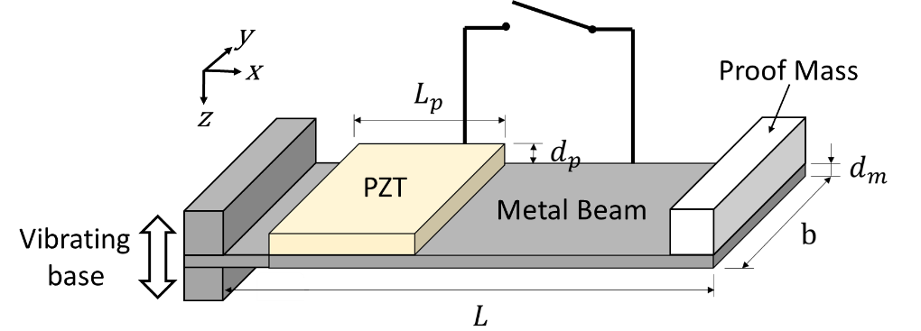
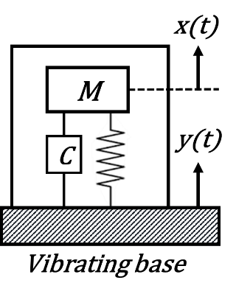
PROPOSED EXPERIMENTAL MODEL
OBJECTIVE OF EXPERIMENT
Determined the ability for piezoelectric-bonded plate to
tune the mechanical characteristic
(which is resonance frequency)
by changing the circuit configurations
(between open circuit and close circuit)
of piezoelectric actuator.[3]
K
Figure 4 : (Left) PZT-Layered Cantilever System, (Right) Equivalent Single Degree of Freedom (SDOF) system
[3]Hui Shena; Jinhao Qiua; Hongli Ji ; Kongjun Zhua; Marco Balsi ; Ivan Giorgio; Francesco Dell’Isola , "A low-power circuit for piezoelectric vibration control by synchronized switching on voltage sources," Sensors and Actuators A: Physical, vol. 161, no. 1-2, pp. 245-255, 2010.
Notes:
Yang ni kena zoom gambar dia

Slide 5
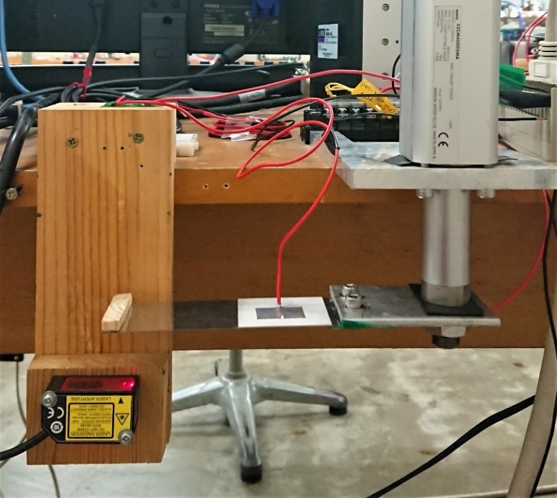
EXPERIMENTAL APPARATUS
LINEAR MOTOR
LINEAR MOTOR
Input parameter for vibration of vibrating base is controlled on PC
Parameter adjustment included
-Range of frequency response experiment
-The increment of frequency response
-The amplitude of vibration
CANTILEVER
LASER SENSOR
Is placed to monitor the displacement of piezoelectric-boded cantilever near the mass loading.
Connected to AD Converter→PC to observe the output graph of frequency response
LASER SENSOR
Is placed to monitor the displacement of piezoelectric-boded cantilever near the mass loading.
Connected to AD converter→PC to observe the output graph of frequency response
LASER SENSOR
Figure 5 : Picture of actual experiment setup apparatus

Slide 6
METHODOLOGY
STEPS OF EXPERIMENT
Condition check of experimental apparatus
Constant variable for all experiments
Frequency Range : 20Hz ~ 40Hz
Frequency Increment : 1Hz
Manipulated variable ⇒ Circuit configurations
1st : Few cycle of experiment with short circuit configurations
2nd : Few cycle of experiment with open circuit configurations
3rd : Few cycle of experiment with alternate circuit configurations
REPEATABILITY OF FREQUENCY RESPONSE
To qualify the reliability of the obtained result
the frequency response is carried out without changing any parameter including the circuit configuration for few cycle.
Notes:
Tgk balik scale

Slide 7
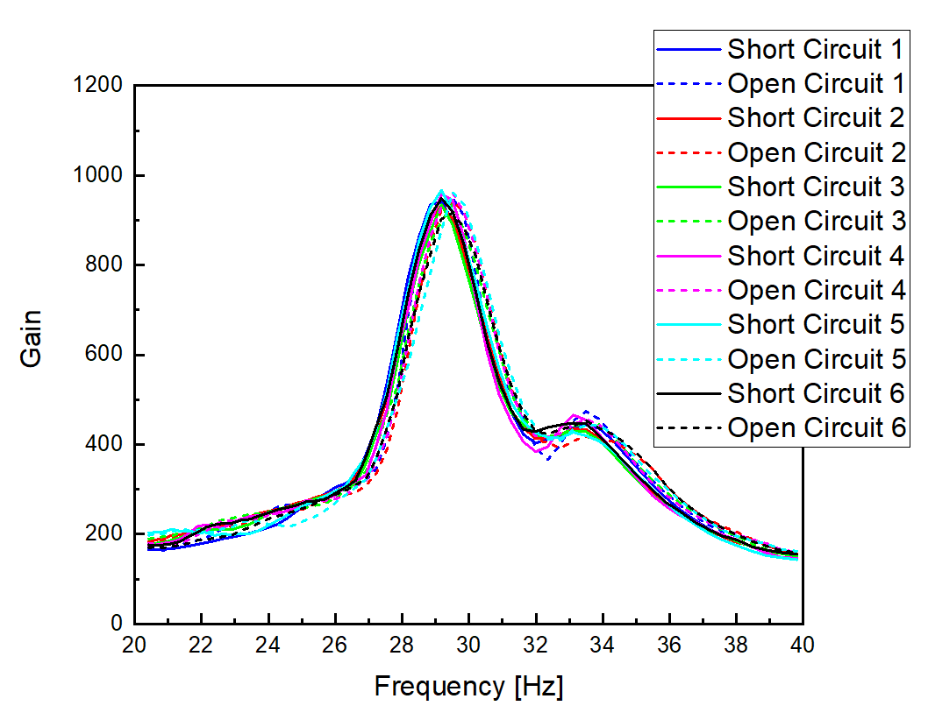
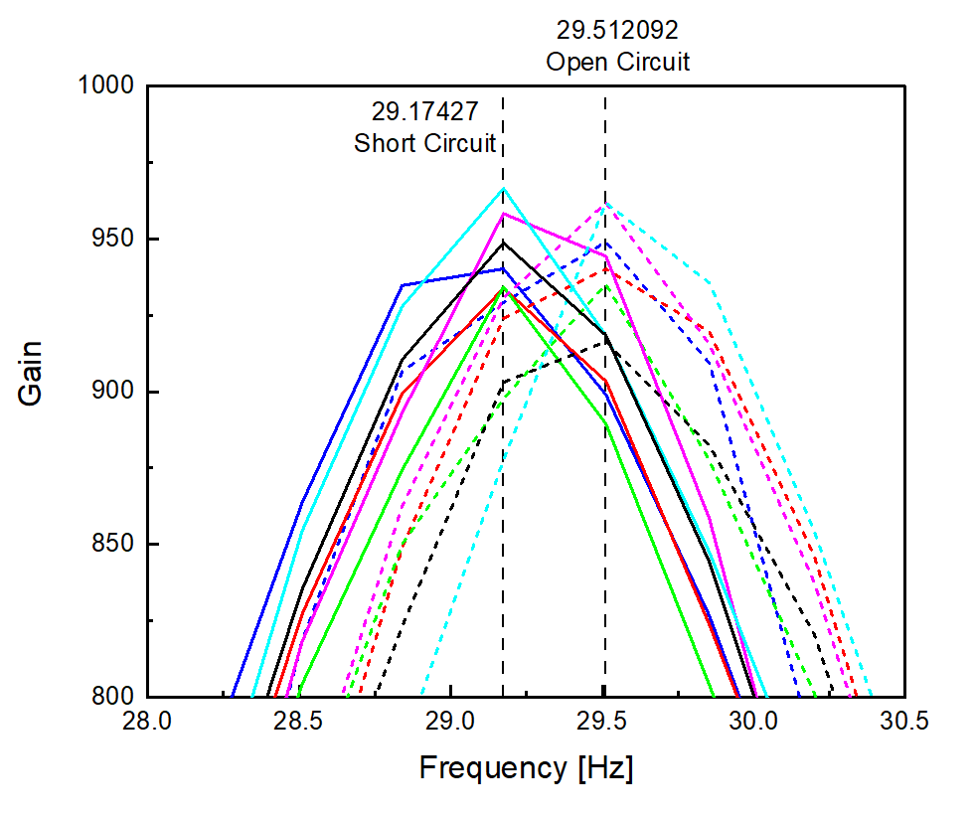
EXPERIMENTAL RESULT
ALTERNATE CIRCUIT CONFIGURATIONS
EXPERIMENTAL VALUE OF RESONANCE FREQUENCY, f
SHORT CIRCUIT OPEN CIRCUIT
29.174Hz 29.512Hz
7
7

Slide 8
THEORETICAL CALCULATION OF RESONANCE FREQUENCY 1
RESONANCE FREQUENCY, f
$$f=\frac{1}{2π}\sqrt{\frac{K}{M}}$$
STIFFNESS OF CANTILEVER, K [4]
$$K=\frac{9 EI E_{m}I_{m}}{\left.2 EI {\left(L−L_{p}\right)}^{3}+5 E_{m}I_{m }{L_{p}}^{3}+9 E_{m}I_{m} {L_{p}}^{2}(L−L_{p}\right)}$$
$EI$ is flexural rigidity of PZT-metal beam composite
$E_{m}I_{m}$ is flexural rigidity of metal beam
SEISMIC MASS, M
$$M=M_{tip}+\frac{33}{140}M_{beam}$$
Where Mass of beam $M_{beam} is define as$ ,
$$M_{beam}=ρ_{m}Lbd_{m}+ρ_{p}L_{p}bd_{p}$$
YOUNG MODULUS RELATION OPEN & SHORT CIRCUIT [5]
$$E_{p_open}=E_{p_short}\frac{1}{1−{k_{31}}^{2}}$$
[4]Zhoua, L. Suna, Zhenga, S. Denga, J. Zhaoa, S. Penga, Y. Zhanga, X. Wangb and H. Chengb, "A model for the energy harvesting performance of shear mode piezoelectric cantilever,," Sensors and Actuators A: Physical, vol. 179, pp. 185-192, 2012.
[5] O. Guillon, F. Thiebaud, P. Delobelle and D. Perreux, "Tensile behavior of PZT in short and open-circuit conditions," Materials Letters, vol. 58, pp. 986– 990, 2004.
8

Slide 9
THEORETICAL CALCULATION OF RESONANCE FREQUENCY 2
=0.008kg
 | Metal Beam | PZT
 | $SUS430$ | $$Pb\left(Zr·Ti\right)O_{3}$$
$$Density [kg/m^{3} ]$$ | $$ρ_{m}=7.8×{10}^{3}$$ | $$ρ_{p}=7.65×{10}^{3}$$
$$Young ratio [Pa]$$ | $$E_{m}=2×{10}^{11}$$ | $$E_{p_open}=6.2×{10}^{10}$$
 |  | $$E_{p_short}=7.3×{10}^{10}$$
$${Poisson}^{′}s ratio$$ | $$ν_{m}=0.275$$ | -
$$Size [{mm}^{3}]$$ | $$L×d_{m}×b$$ | $$L_{p}×d_{p}×b$$
 | $$115×0.3×40$$ | $$45×0.5×40$$
SUBSTITUTE THESE PARAMETER INTO EQUATIONS TO CALCULATE
RESONANCE FREQUENCY, f
SHORT CIRCUIT OPEN CIRCUIT
32.00Hz 32.36Hz
Notes:
Yang ni kena zoom gambar dia、dn letak bilangan rekahan

Slide 10
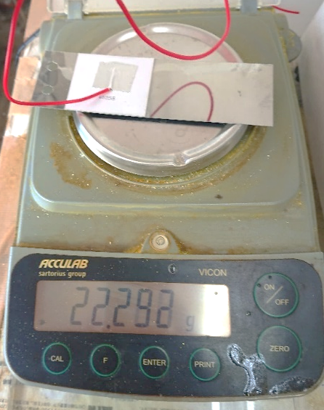
DISCUSSION 1
RELATION BETWEEN THEORETICAL AND EXPERIMENTAL VALUE OF RESONANCE FREQUNCY
THEORETICAL VALUE
EXPERIMENTAL VALUE
SHORT CIRCUIT
32.00Hz
OPEN CIRCUIT
32.36Hz
SHORT CIRCUIT
29.17Hz
OPEN CIRCUIT
29.51Hz
REASON : EFFECT OF DIFFERENT MASS VALUE
$$f =\frac{1}{2π}\sqrt{\frac{K}{M}}$$
Mass of beam in calculation : 17.649g
Mass of beam in experiment : 22.292g

Slide 11
DISCUSSION 2
RELATION OF RESONANCE FREQUENCY IN OPEN AND SHORT CIRCUIT CONFIGURATION
THEORETICAL VALUE
SHORT CIRCUIT OPEN CIRCUIT
32.00Hz 32.36Hz
due to
their ability to change their mechanical compliance, caused
by changes in their electrical impedance when connected in
open or short circuit.
During open circuit, the piezoelectric actuator is able to
store more potential energy due to its higher stiffness and
inherent capacitance, when switched to low stiffness (i.e.
short circuit), the piezoelectric is able to dissipate the
energy effectively as the capacitor is shunted to short and
the stiffness becomes low.
EXPERIMENTAL VALUE
SHORT CIRCUIT OPEN CIRCUIT
29.17Hz 29.51Hz
REASON : EFFECT OF DIFFERENT STIFFNESS VALUE
$$f=\frac{1}{2π}\sqrt{\frac{K}{M}}$$
short circuit stiffness < open circuit stiffness
due to their ability to change their mechanical compliance, caused by changes in their electrical impedance when connected in open or short circuit.

Slide 12
CONCLUSION
Prove that the inverse-piezoelectric effect of the piezoelectric-bonded plate is reproducible and can be considered to be implemented in the application of SADC as semi-active control by monitoring the circuit configuration.
AUTOMATIC MONITORING ⇒ The implementation of photoswitch in the electrical circuit configuration of piezoelectric-bonded plate is a significant way in tuning the resonance frequency of the device.
FURTHER IMPROVEMENT ⇒ deriving resistor in the circuit can allow better parameter control in tuning the resonance frequency of the piezoelectric-bonded plate.

